Slide 1
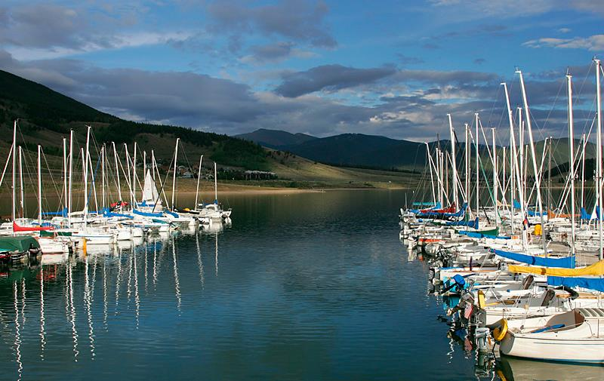
From the Peaceful Serenity of this World Renown Sailing Venue, We Interrupt this Zen Moment to Bring You…

Slide 2
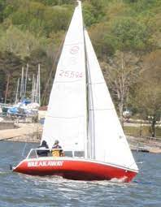
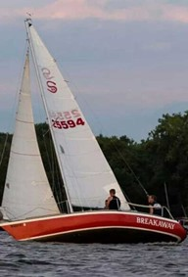
All Comers…Load Up and Bring Your Best Shot to….
This Photo by Unknown Author is licensed under CC BY-NC
The Duel @ Dillon

Slide 3
Why Dillon? If You Must Ask, then…
Among the most beautiful Racing Venues in the World (Yeh, Lake Como!)
50 years of experience hosting major regattas (Stay Tuned)
Extremely well managed Marina w/ “Concierge Level” Services
Full Service Marine Chandlery on site for Repairs and Re-Supply
Full Scale Mountain Resort Amenities all within Walking Distance
All Levels of Housing – Camping to 5 Star – at all Price Points an all within walking distance to Marina, Grocery Stores, Dining, Drinking ad More
Surrounded by Four Towns – Dillon, Frisco, Breckenridge, Silverthorne
Unlimited Local Activities for Spouses, Family & Friends to Enjoy – Boating, Fishing, Hiking, Biking, Off Road Tours, Top o’ World Views, Outlet Shopping
An Unparalleled Combination that is hard to Duplicate Anywhere

Slide 4
Dillon YC History Hosting Major Regattas
Dillon Yacht Club is known world-wide for attracting numerous Major Championship Level Regattas with its reputation as the “World’s Highest Yacht Club” (no cannabis puns here please, though likely relevant)
50+ Years of the Dillon Open… Attracts as many as 200 boats from 6 States
Ski Yachting Championships
Junior Olympics (5 times)
Fireball Nationals and North Americans
Snipe Nationals, Buccaneer Nationals
J 24 North Americans , J-24 Districts (Continuously since 1987, yes that’s 36 years)
Etchells Regionals (10 years running), Ensign Regionals (15 Years running)
International Star Districts
Santana 20 Championship – Twice Already, Shooting for Three

Slide 5
Collaboration for Maximum Exposure
Be Willing to Try Something Different for Specific Benefits?
Combine our Class Championships with the Dillon Open!
Increase Class Exposure while Reducing Costs Significantly
Reduce Entry Fees to 2004 Levels, rolling it back 20 Years!!
Sponsors: Dillon Open-20- and Santana 20 already 2 Committed
More Social Amenities –Big Tent, Dinners, Bar, Bands, Dancing
Santana 20 Class Exposition & Recruitment
Still Maintain our Class Traditions w/ Distinct Events…Practice Race, “Andrew Talk”, Race Re-caps, Special Meals, Trophies
Capitalize on Past Successes and make it Even Better

Slide 6
Dillon YC & Marina Support Letters
Dillon Yacht Club
World’s Highest at 9,017ft
P.O. Box 4308 Dillon, CO 80435
www.dillonyachtclub.com July 15, 2023
Joe Quarantillo
Commodore of the Dillon Yacht Club
Dillon, Colorado 80435
970.406.0971, commodore.quarantillo@gmail.com
Hosting the 2024 Santana 20 Nationals
To whom it may concern.
I would like to voice my excitement considering the opportunity to host the Santana 20 National Championships in 2024. I am the current Commodore of the Dillon Yacht Club and part of the organizing committee for our annual Dillon Open. We have hosted Regional and National level events for other classes during the Dillon Open in the past and the opportunity to host such a strong local fleet at the Open is exciting! The Dillon Open generally begins Friday evening with on-site registration (if not preregistered) and packet pick up, as well as a cookout of some sort. During this time we can facilitate your class needs for weigh-in and boat inspection if needed. Participants can crane or ramp launch depending on the skipper’s needs. Saturday will be filled with the best conditions Mother Nature can offer on the day, followed by an incredible evening of dinner and dancing. Sunday will be a repeat in racing followed by awards and thank you’s. We hope you and the selection committee can find it possible to allow the Dillon Yacht Club to host your 2024 National Championship. Please feel free to reach out if you would like more information about the venue, conditions, or specific requests for your event.
Warm Regards, Joe Quarantillo

Slide 7
Dillon YC & Marina Support Letters
June 13,2023
To: | Derek Hardy, Class President Santana 20 Class Association
From: | Craig Simson, Marina Director
Subject: | Santana 20 Nationals
I would like to introduce myself. My name is Craig Simson and I am the current Director for the Dillon Marina, CO. It has come to my attention that there is a possibility of hosting the Santana 20 Nationals at our Marina in 2024.
I would like to express that as a former Santana 20 owner, avid sailor and Director of the Dillon Marina, I and we stand in full support of this possibility and would look forward to the opportunity to host such a great event. Dillon Reservoir is an amazing place to sail and our full service marina is ready, willing and able to take care of the fleets needs.
Thank you for your consideration,
Craig Simson
Marina Director
Dillon Marina, CO
craigs@dillonmarina.com

Slide 8
The Committee of Volunteers
Early Planning leads to better Results… from a team experienced in managing all facets of a National Championship Regatta
DYC & PRO Liaison Chairperson – Frank Keesling
Finance Coordinator – Phyllis Albritton
Sponsor Chairperson – Jorge
Social & Hospitality Chairperson – April Little
Marina Liaison Coordinator – Jim Bogner
Measurement Chairperson - Michael McKeever
Scoring & Results – Lorin Paul
National Publicity – Andrew Kerr
Regatta Co-Chairs – Cindy Klyn & Phillip

Slide 9
Tentative Schedule of Events
Wed, 8/21 - Early Arrivals, Concierge Services, Mast Up Crew
Thurs 8/22 - Arrivals, MUC, Concierge Services, Registration,
Measurements as needed, 1st Timer Seminar
Friday 8/23 - Welcome, Participants Meeting, Annual Meeting,
Practice Race(s)
Sat 8/24 - Three Races Scheduled, Dinner
Sun 8/25 - Three Races Scheduled, Dinner
Mon 8/26 - Three Races Scheduled, Trophies, Farewell Dinner

Slide 10
Communication Strategy
We aim to draw as many boats as possible and we will not be sitting on our hands, but reaching out every way possible with a proactive communication program, especially touching those not in Fleet 19 or 28, but beyond
Monthly Updates 12 months out
Six Month and Three-Month Participant Surveys
Personal Contact with each potential participant in remote locations
Onsite “Tuning Visits” to Idaho, Montana, Texas to encourage 1st Timers
Concierge Services for Logistics and any unresolved needs
Sending out “Home Court Hints” to Registrants
Set 1/2 Day “Nationals Orientation & Speed Hints” for First Timers
Welcome Package sent out to all Participants One Month Out
Concierge Welcome Team meeting each arrival with Swag Bag

Slide 11
Participant Survey – Distributed at Intervals
First Out to All Members right after Save the Dates in August
Follow-up Every Two Months, Other Questions Added Later to Known Participants
2024 Santana 20 Championships at Dillon - Participant Survey
Greetings. We hope you are getting pumped to come to the Duel @ Dillon in August 22-26, 2024. To help us help you, please respond to a few quick questions below so we can begin to determine numbers and offer our assistance to make your participation a great experience for you, your crew, family and friends. If there is anything you need, just let us know and we are here to help in any way we can to facilitate your participation and join in the fun.
Yes No (Please answer Yes or No as indicated. If you need more space, add lines or insert at bottom of page.)
X Are you planning on coming to the 2024 Class Championship in Dillon, CO? Boat Name and # here please: #
If still undecided, what can we tell you that can facilitate your final decision?
What is most important to you about attending a major regatta that may affect your participation?
X If you are not planning to attend, might you make your boat available for Charter?
If yes, let us know any information to provide to potential Charterers (we will have a handful)
X Will you be camping (Yes) or staying in a cabin/house/hotel or other (No)
If you are camping, have you made a reservation? If No, please tell us if you need local information.
X If your team consists of more than the three who are on the boat, please insert # of added folks in (Yes)
4 Will your team be joining us for Dinner on Friday, Sunday and Monday? Note: Saturday Dinner on Dillon Open. If yes, insert # of folks in (Yes)
X If any team member has any food allergies, please note here: Bad Regatta Food
For Non-Sailing Team Members, what types of things may interest them? (Spectator Boats, Boat Rentals, Rafting, Hiking, Fly-Fishing, Off-Road Treks, Horseback Riding, Outlet Shopping?)
X Do you have a valid Certificate for your boat? If no, please answer below
X Will you be measured on Site or made other arrangements w/ your local Fleet Measurer?
X (Later) Have you reviewed the Checklist of Required Items on your boat?
X (Later) Have you reviewed our Code of Conduct for the Regatta?
Is there is anything we can help you with, to assist with your planning, please let us know below:
(Later) Approximate time you expect to arrive at Dillon Marina - day & time
Best name, email and contact # for your team: Name: Email: Phone: Skipper: Crew: Crew:
Reduced Sample Only

